Slide 1

POWER AND POLITICS
Power and politics play a significant role in shaping organizational design and behavior, influencing various aspects of how an organization operates and evolves.
Understanding and navigating power dynamics and political behaviors are crucial for leaders and organizations to create a conducive work environment, promote fairness, enhance collaboration, and achieve their objectives while maintaining ethical standards and employee well-being.
Power and Politics affects:-
Decision-Making Processes
Organizational Structure
Leadership and Management Styles
Organizational Culture and Dynamics
Employee Behaviour and Engagement
Navigating Dynamics for Success

Slide 2
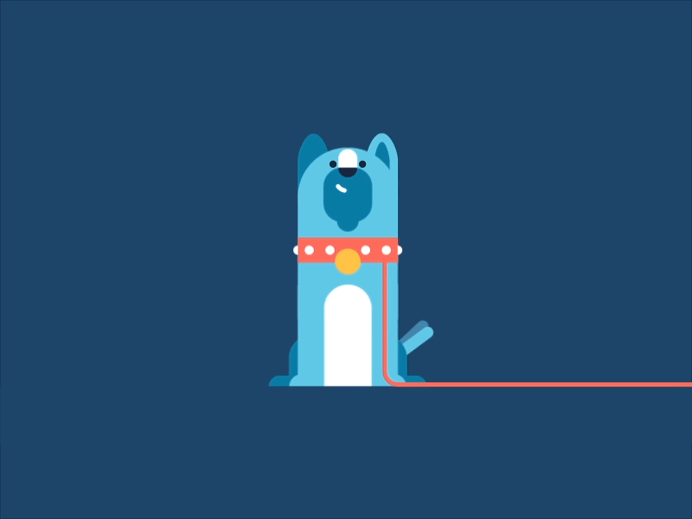
Definition of Power and Politics
The ability to influence others’ behaviors, decisions and outcomes.
The process of influencing decision-making and resource allocation.
Power
Politics

Slide 3

Types of Power
Legitimate
Reward
Referent
coercive
EXPERT

Slide 4

Reward Power – Person in power gives rewards to ones who perform better. Example – incentives, benefits, salary hike, can be given to employees who perform better.
Coercive power – Person in power will give punishment and threaten others if work is not done properly. It is the most negative form of power. Example – senior employee threatens newly recruited employee to do the work in a specific time period.
Legitimate power – Person in power will use their powers to make others compliant. They have the power to reward and punish. Example – CEO passes any instruction/rules – everyone should follow or they might get punished.
Referent power – officially, they do not have any powerful position, but they are talented, well behaved, so they are respected. Example – senior most employee.
Expert Power – it is based on a persons skill, knowledge, experience. They are highly respected because of their experience in a particular domain.

Slide 5
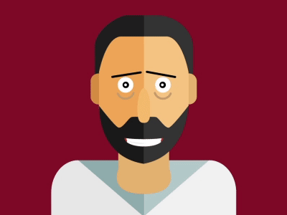
POLITICS IN ORGANIZATIONS
Networking is very important in situations where one is looking for a new job, looking for customers, developing current career, exploring new career options or looking for any form of referrals.
Manipulation – it is a means by which a person is gotten to do something that the person was not initially inclined to do. As such it is a form of power.
Informal strategies to gain advantage.
Political Behavior
Lobbying – an individual or a group of individuals who tries to influence another individual, group, or organization.
Networking – it refers to the ability of an individual or groups of individuals to make contacts, exchange information, share experiences with others.

Slide 6
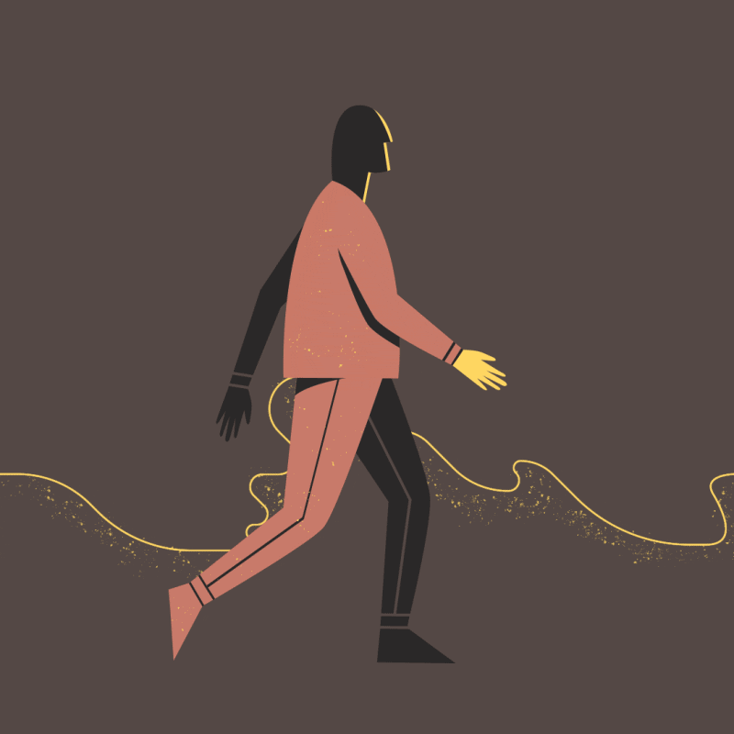
FACTORS AFFECTING ORGANIZATIONAL POLITICS
SCARCE RESOURCES
Competition for Resources – limited resources such as budget, time, or specialized skills often lead to political tactics to secure a larger share for one’s own team or department.
Resources Dependency – when teams or individuals rely on others for crucial resources, they may engage in politics to ensure their needs are met.
DIVERSE INTERESTS AND GOALS
Divergent Priorities – different teams or individuals might have conflicting objectives, leading to political behavior to align decisions with their interests.
Personal Agendas – individuals may pursue personal goals that diverge from organizational objectives, fostering political maneuvers to further their own ambitions.
AMBIGUITY AND UNCERTAINITY
Lack of Clarity – when organizational goals, roles or expectations are unclear, individuals may resort to political behaviors to secure their position or resources.
Uncertain Environments – Rapid changes, unclear future directions, or unstable market conditions can trigger political maneuvering as individuals seek security or advantage.

Slide 7

RELATIONSHIP BETWEEN POWER AND POLITICS
ORGANIZATIONAL STRUCTURES AND POWER
Centralization vs. Decentralization: influence distribution.
Hierarchical vs. Flat Structures: Power distance.
IMPACT ON ORGANIZATIONAL BEHAVIOR
Leadership styles and employee engagement affected by power dynamics.
Organizational culture shaped by political behaviors.
ETHICAL CONSIDERATIONS
Ethical use of power and influence.
Mitigating negative political behaviors for a healthier workplace.

Slide 8

MANAGING POWER AND POLITICS
EMPOWERING EMPLOYEES
Empowerment in decision-making
Creating fair and inclusive cultures
STRATEGIES FOR NAVIGATING ORGANIZATIONAL POLITICS
Building alliances and networks
Transparency and communication
LEADERSHIP’S ROLE
Fostering positive organizational climate
Modeling ethical behavior

Slide 9

CASE STUDY: POWER PLAY IN A CORPORATE RESTRUCTURING
Background
Company X was a global conglomerate operating in various sectors, from technology to finance. Due to market shifts and internal challenges, the company decided to undergo a significant restructuring to streamline operations and boost profitability.
Key Players
CEO: An experienced leader appointed to spearhead the restructuring.
Department Heads: Leaders of various divisions within the company.
Middle Managers and Employees: Affected by the changes and navigating uncertain times.
Situation
As the restructuring plans unfolded, it became evident that certain departments would face downsizing while others would expand. This triggered a series of power struggles and political maneuvers within the organization.

Slide 10

POWER DYNAMICS
POLITICAL BEHAVIORS
Centralized Decision-Making: The CEO held significant power in determining the restructuring strategies and resource allocation.
Department Heads' Influence: They wielded power due to their control over teams and resources within their divisions.
Coalition Formation: Department heads formed alliances to protect their units and resources, lobbying the CEO for favorable treatment.
Information Hoarding: Some individuals strategically withheld information to gain an advantage or prevent certain changes that might affect their positions negatively.
Rumors and Speculations: Unverified information circulated, causing uncertainty among employees and fostering distrust.

Slide 11

CONSEQUENCES
POSITIVE OUTCOMES:
NEGATIVE OUTCOMES:
Efficiency Improvements: Some departments adapted quickly to changes, increasing productivity and efficiency.
Strategic Alignment: The restructuring aligned certain units with the company's long-term vision, enhancing their effectiveness.
Internal Strife: Competition among departments led to conflicts, affecting collaboration and morale.
Employee Disengagement: Uncertainty about job security and future roles caused stress and lowered productivity.
Trust Erosion: Lack of transparency and perceived favoritism eroded trust in leadership and the decision-making process.

Slide 12

RESOLUTION AND LESSONS LEARNED:
Leadership Intervention: The CEO initiated clear communication sessions, addressing concerns and clarifying the vision behind the restructuring.
Transparency and Fairness: Efforts were made to ensure transparency in decision-making and fairness in resource allocation.
Empowerment and Inclusivity: Encouraging input from all levels improved employee engagement and fostered a more inclusive approach to change management.
TAKEAWAYS:
Power Dynamics Impact Restructuring: Hierarchical power and influential positions significantly shape how restructuring is perceived and executed.
Politics Affect Organizational Climate: Political behaviors can disrupt organizational harmony, affecting morale and productivity.
Transparency Mitigates Negative Effects: Open communication and fairness in decision-making are vital in managing the impact of restructuring.

Slide 13

CONCLUSION
This case study highlights how power dynamics and political behaviors can significantly impact organizational changes like restructuring. It emphasizes the importance of effective leadership, transparency, and inclusivity in managing such situations to minimize negative consequences and foster a more positive organizational environment.

